Slide 1

Applied Use Cases of the Health-RI Semantic Interoperability Initiative
Status: paused as of May 1, 2026.
Pedro Paulo F. Barcelos {Pedro.Barcelos@health-ri.nl}, Niek van Ulzen,
Reinier Groeneveld, Ana Konrad, Douwe Spaanderman, and Shuxin Zhang
Notes:
Welcome. In this presentation, I will walk you through applied use cases from the Health-RI Semantic Interoperability Initiative.
The focus is on how semantic technologies can support practical decisions in health data reuse. Rather than discussing interoperability in the abstract, we will follow a concrete user journey through a series of scenarios and show how meaning can be made explicit, compared, and reused across datasets.

Slide 2

Amir Hassan: Research Goal and Challenge
Amir is studying whether treatment outcomes differ across patient groups and needs to stratify his cohort using the correct sex/gender-related variable.
Before requesting data, he must identify which datasets contain the right variable for his study.
Dr. Amir Hassan — Researcher
Notes:
We now introduce the primary user for the presentation: Dr. Amir Hassan, a researcher preparing to reuse health data for analysis.
Amir is studying whether treatment outcomes differ across patient groups. To do that, he needs to stratify his cohort using the correct sex- or gender-related variable.
At first, this may sound straightforward. Many datasets contain variables that appear to describe sex or gender.
But before Amir can request data, he needs to know which datasets contain the concept he actually needs, and whether similar variables are defined in the same way across institutions.
This is the central challenge: the labels may look familiar, but the underlying meanings may not be the same.

Slide 3
Scenario 1: Clarify Meanings Before Reuse
Scenario 1: Clarify Meanings Before Reuse
Scenario 2
Result
Scenario 3
Scenario 4
Notes:
We now move into the first applied scenario: clarifying meanings before reuse.
Before selecting or combining datasets, Amir needs to understand the landscape of related concepts. Although sex- and gender-related variables may appear similar at first glance, they can be based on very different aspects of a person’s identity or record, including biological characteristics, social identity, legal status, or the perspective of the person or institution defining the information.
At this step, Amir is trying to understand what is out there: which sex- and gender-related meanings are represented in the available datasets, how they differ from one another, and which one best matches what he needs for his study.
This is the first step in Amir’s workflow toward a more defensible decision about data reuse.

Slide 4
Scenario 1: Amir’s Question and Challenge
What Amir wants
Use the correct sex/gender-related variable to create a cohort that can support trustworthy analysis.
Amir’s challenge
Similar-looking variables across datasets may represent different meanings, making reuse risky.
Guiding question
How can Amir avoid risky reuse when similar-looking variables may represent different meanings?
Notes:
This slide makes Amir’s question explicit.
He wants to build a valid cohort by using the sex- or gender-related variable that best fits his research question.
The challenge is that several datasets may appear to contain similar information. But if those variables represent different meanings, treating them as equivalent could distort the study results.
So Amir’s guiding question is: how can he understand the relevant semantic differences before comparing or reusing these datasets?

Slide 5






Available Sex and Gender Variables by Dataset
patient_id | care-sm:Sex ("Biological sex"@en) | birth_year | residence_code
NPR-001 | female | 1987 | 0363
NPR-002 | male | 1979 | 0599
NPR-003 | female | 1994 | 0518
NPR Demographic Extract
person_id | hri-openehr:legal-gender ("Legal gender"@en) | encounter_id | record_date
NMC-001 | female | ENC-7001 | 2026-01-14
NMC-002 | male | ENC-7002 | 2026-01-15
NMC-003 | nonbinary | ENC-7003 | 2026-01-16
Hospital Registration Extract
intake_id | loinc:107454-1 ("Administrative gender"@en) | questionnaire_id | submitted_date
RPCC-001 | woman | GIQ-001 | 2026-02-03
RPCC-002 | man | GIQ-001 | 2026-02-03
RPCC-003 | non-binary | GIQ-002 | 2026-02-04
Administrative Intake Extract
Scenario 1
Notes:
Amir is now looking at three illustrative dataset options. These are fictional examples, designed to make the scenario realistic while keeping the focus on the semantic problem.
The first dataset is the NPR Demographic Extract. It includes a variable from Care-SM: care-sm:Sex, labeled “Biological sex.”
The second is the Hospital Registration Extract. It includes an openEHR-based variable: hri-openehr:legal-gender, labeled “Legal gender.”
The third is the Administrative Intake Extract. It includes a LOINC variable, labeled “Administrative gender.”
At first glance, all three datasets seem relevant to Amir’s question. But they do not necessarily represent the same kind of information. This is the point Amir needs to clarify before deciding which dataset can support his study.

Slide 6
Labels and their Meanings
patient_id | care-sm:Sex ("Biological sex"@en) | birth_year | residence_code
NPR-001 | female | 1987 | 0363
NPR-002 | male | 1979 | 0599
NPR-003 | female | 1994 | 0518
NPR Demographic Extract
Same term. Do they share the same meaning?
person_id | hri-openehr:legal-gender ("Legal gender"@en) | encounter_id | record_date
NMC-001 | female | ENC-7001 | 2026-01-14
NMC-002 | male | ENC-7002 | 2026-01-15
NMC-003 | nonbinary | ENC-7003 | 2026-01-16
Hospital Registration Extract
What is the difference between ‘man’ and ‘male’?
intake_id | loinc:107454-1 ("Administrative gender"@en) | questionnaire_id | submitted_date
RPCC-001 | woman | GIQ-001 | 2026-02-03
RPCC-002 | man | GIQ-001 | 2026-02-03
RPCC-003 | non-binary | GIQ-002 | 2026-02-04
Administrative Intake Extract
Scenario 1
Notes:
These three datasets now show why labels alone are not enough.
For example, the value “female” appears in more than one dataset. But “female” in a biological sex column is not necessarily equivalent to “female” in a legal gender column.
We also see related terms such as “man” and “male.” These may look similar, but they do not necessarily refer to the same concept.
This highlights an important distinction: there is the value itself, and there is the meaning of the column in which that value appears.
So Amir should not only ask whether labels match. He needs to know whether the underlying meanings align.
This is why precise and explicit definitions are essential for responsible and reproducible data reuse.

Slide 7
Similar Labels Can Mislead Reuse
(Biological) Sex: Male
Patient-002
(Biological) Sex: Male
Patient-001
(Social) Gender: Male
(Social) Gender: Female (Trans)
Patient-003
(Biological) Sex: Female
(Social) Gender: Non-binary
Scenario 1
Notes:
We continue with a simple example that shows why similar labels can mislead reuse.
Here we see three patients. Each patient has information about biological sex and social gender.
The important point is that these are not the same variable.
Patient 1 has male biological sex and male social gender. Patient 2 has male biological sex, but their social gender is recorded as female. Patient 3 has female biological sex and non-binary social gender.

Slide 8
Similar Labels Can Mislead Reuse
Patient-001
(Biological) Sex: Male
(Social) Gender: Male
Patient-002
(Biological) Sex: Male
(Social) Gender: Female (Trans)
Patient-003
(Biological) Sex: Female
(Social) Gender: Non-binary
Identify patients with male biological sex for a study where biological sex is the intended criterion.
Retrieve patients where Gender = Male.
Returns Patient-001 only, incorrectly missing Patient-002, whose biological sex is male but gender is female/trans.
Identify patients who socially identify as male for gender-based analysis.
Retrieve patients where Sex = Male.
Returns Patient-001 and Patient-002, incorrectly including Patient-002, whose gender is female/trans.
Identify patients with female gender for a study about social gender identity.
Retrieve patients where Sex = Female.
Returns Patient-003 only, incorrectly missing Patient-002, whose gender is female.
Scenario 1
Notes:
This slide shows what can go wrong if Amir uses the wrong variable for his research question.
If the intended criterion is male biological sex, but Amir filters on gender equals male, he retrieves only Patient 1. He misses Patient 2, whose biological sex is male.
If the intended criterion is social gender, and Amir wants patients who socially identify as male, filtering on sex equals male retrieves Patient 1 and Patient 2. But Patient 2 should not be included for that question, because their social gender is recorded as female, with trans indicated.
And if Amir wants patients with female gender, but filters on sex equals female, he retrieves only Patient 3. He misses Patient 2.
So the issue is not simply a technical filtering mistake. It is a semantic mistake: the query uses a variable whose meaning does not match the study criterion.

Slide 9
Distinct Concepts Within Sex and Gender
Sex and Gender are not single, uniform meanings; each branches into multiple interpretations/specializations.
Before comparing dataset variables, we must distinguish which specialization a concept actually refers to.
Sex/Gender
care-sm:Sex
("Biological sex"@en)
(Biological) Sex
(Social) Gender
loinc:107454-1
("Administrative gender"@en)
Sex at Birth
Self-Identified Gender
Administrative Gender
…
hri-openehr:legal-gender
("Legal gender"@en)
Karyotypical Sex
Legal Gender
…
Scenario 1
Notes:
Here we can see that sex and gender are not single, uniform meanings. Each can be specialized into several related but different concepts.
For example, biological sex, sex at birth, and karyotypical sex are not automatically the same thing. In the same way, social gender, self-identified gender, administrative gender, and legal gender refer to different kinds of information.
So, before Amir compares variables across datasets, he needs to understand which specific meaning each variable refers to, and how those meanings relate to one another.

Slide 10
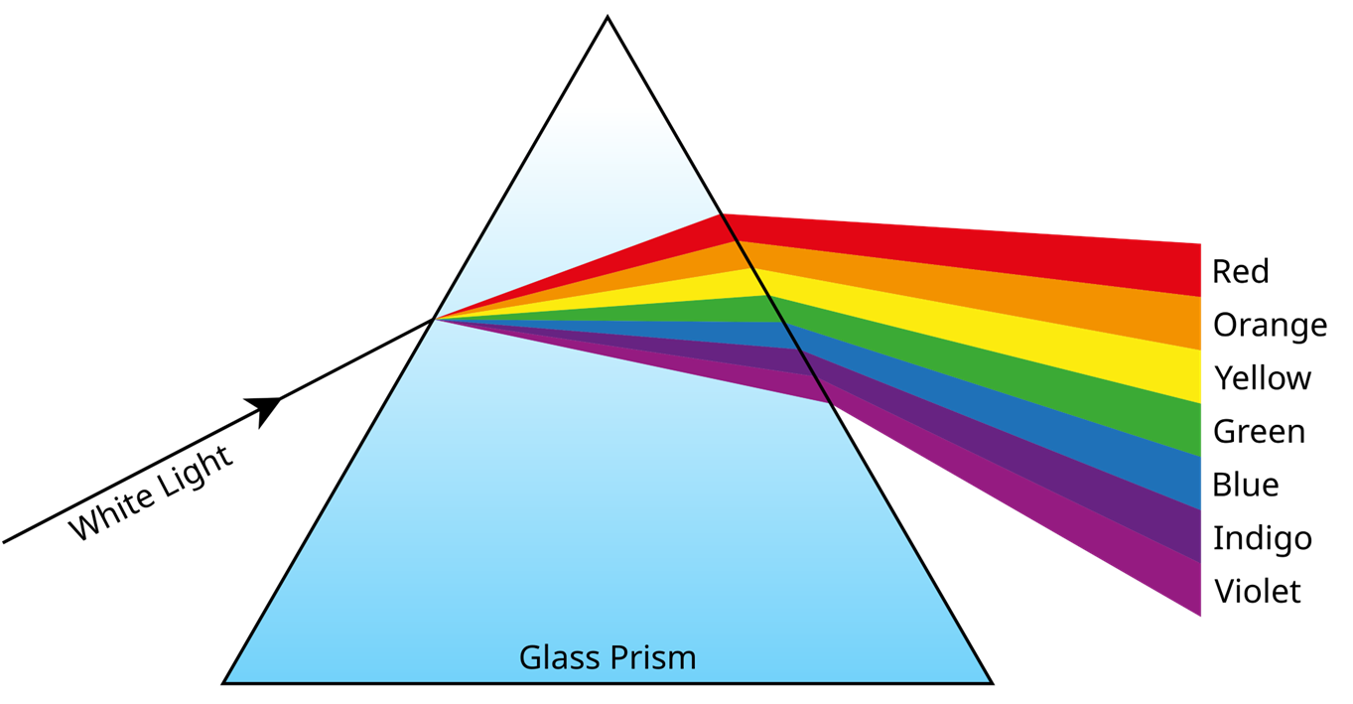
One Label, Many Possible Meanings unpacking meanings

Slide 11
One Label, Many Possible Meanings unpacking meanings
“The opposite of ontology is not non-ontology,
but just bad ontology.”
(prof. Guizzardi, creator of UFO and OntoUML)
Labels do not determine meanings.
We need expressive and precise ontologies!
We need ontologies!
current care recipient
historical patient
registered patient
insured beneficiary
referred patient
admitted patient
waitlisted patient
Patient
(overloaded concept)

Slide 12




The Health-RI Conceptual Ontology
The Health-RI Semantic Interoperability Initiative
1
Conceptual clarification:
Meanings are precise and explicit
HRIM
Mapping Set
HRIO
Conceptual
HRIO
Computational
Scenario 1
Notes:
To support this kind of clarification, we use HRIO: the Health-RI Ontology.
The Health-RI Ontology makes the intended meanings of variables precise and explicit. It uses OntoUML: a modeling language designed to describe concepts and their relationships in a clear and unambiguous way.

Slide 13
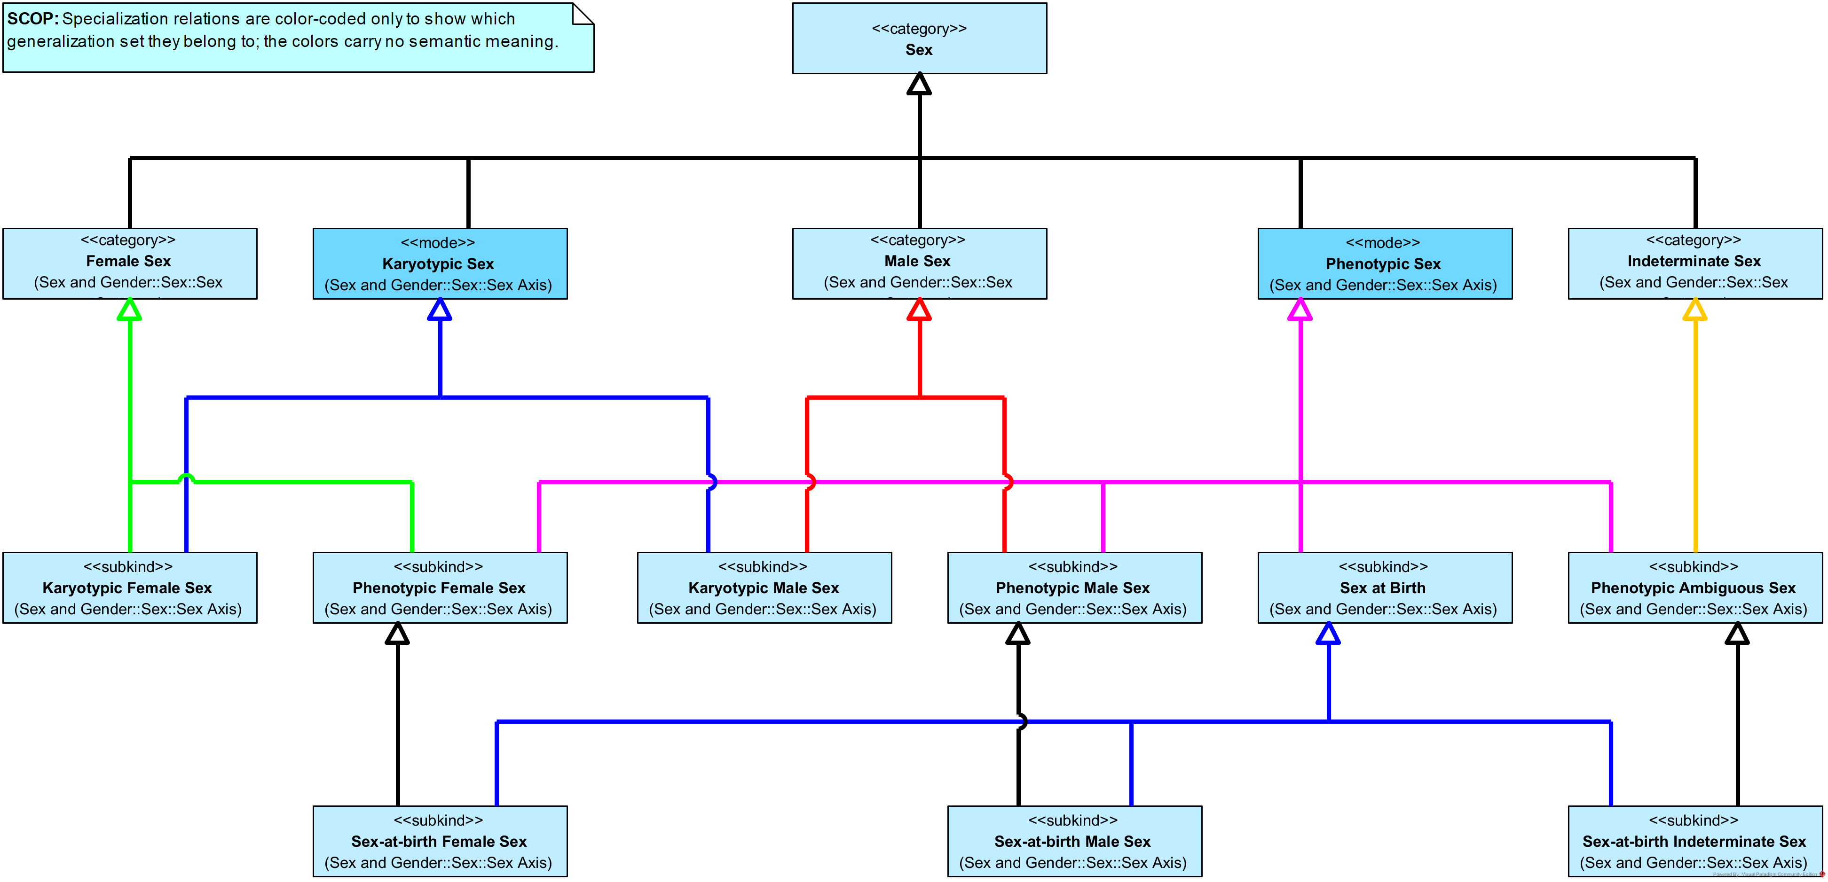
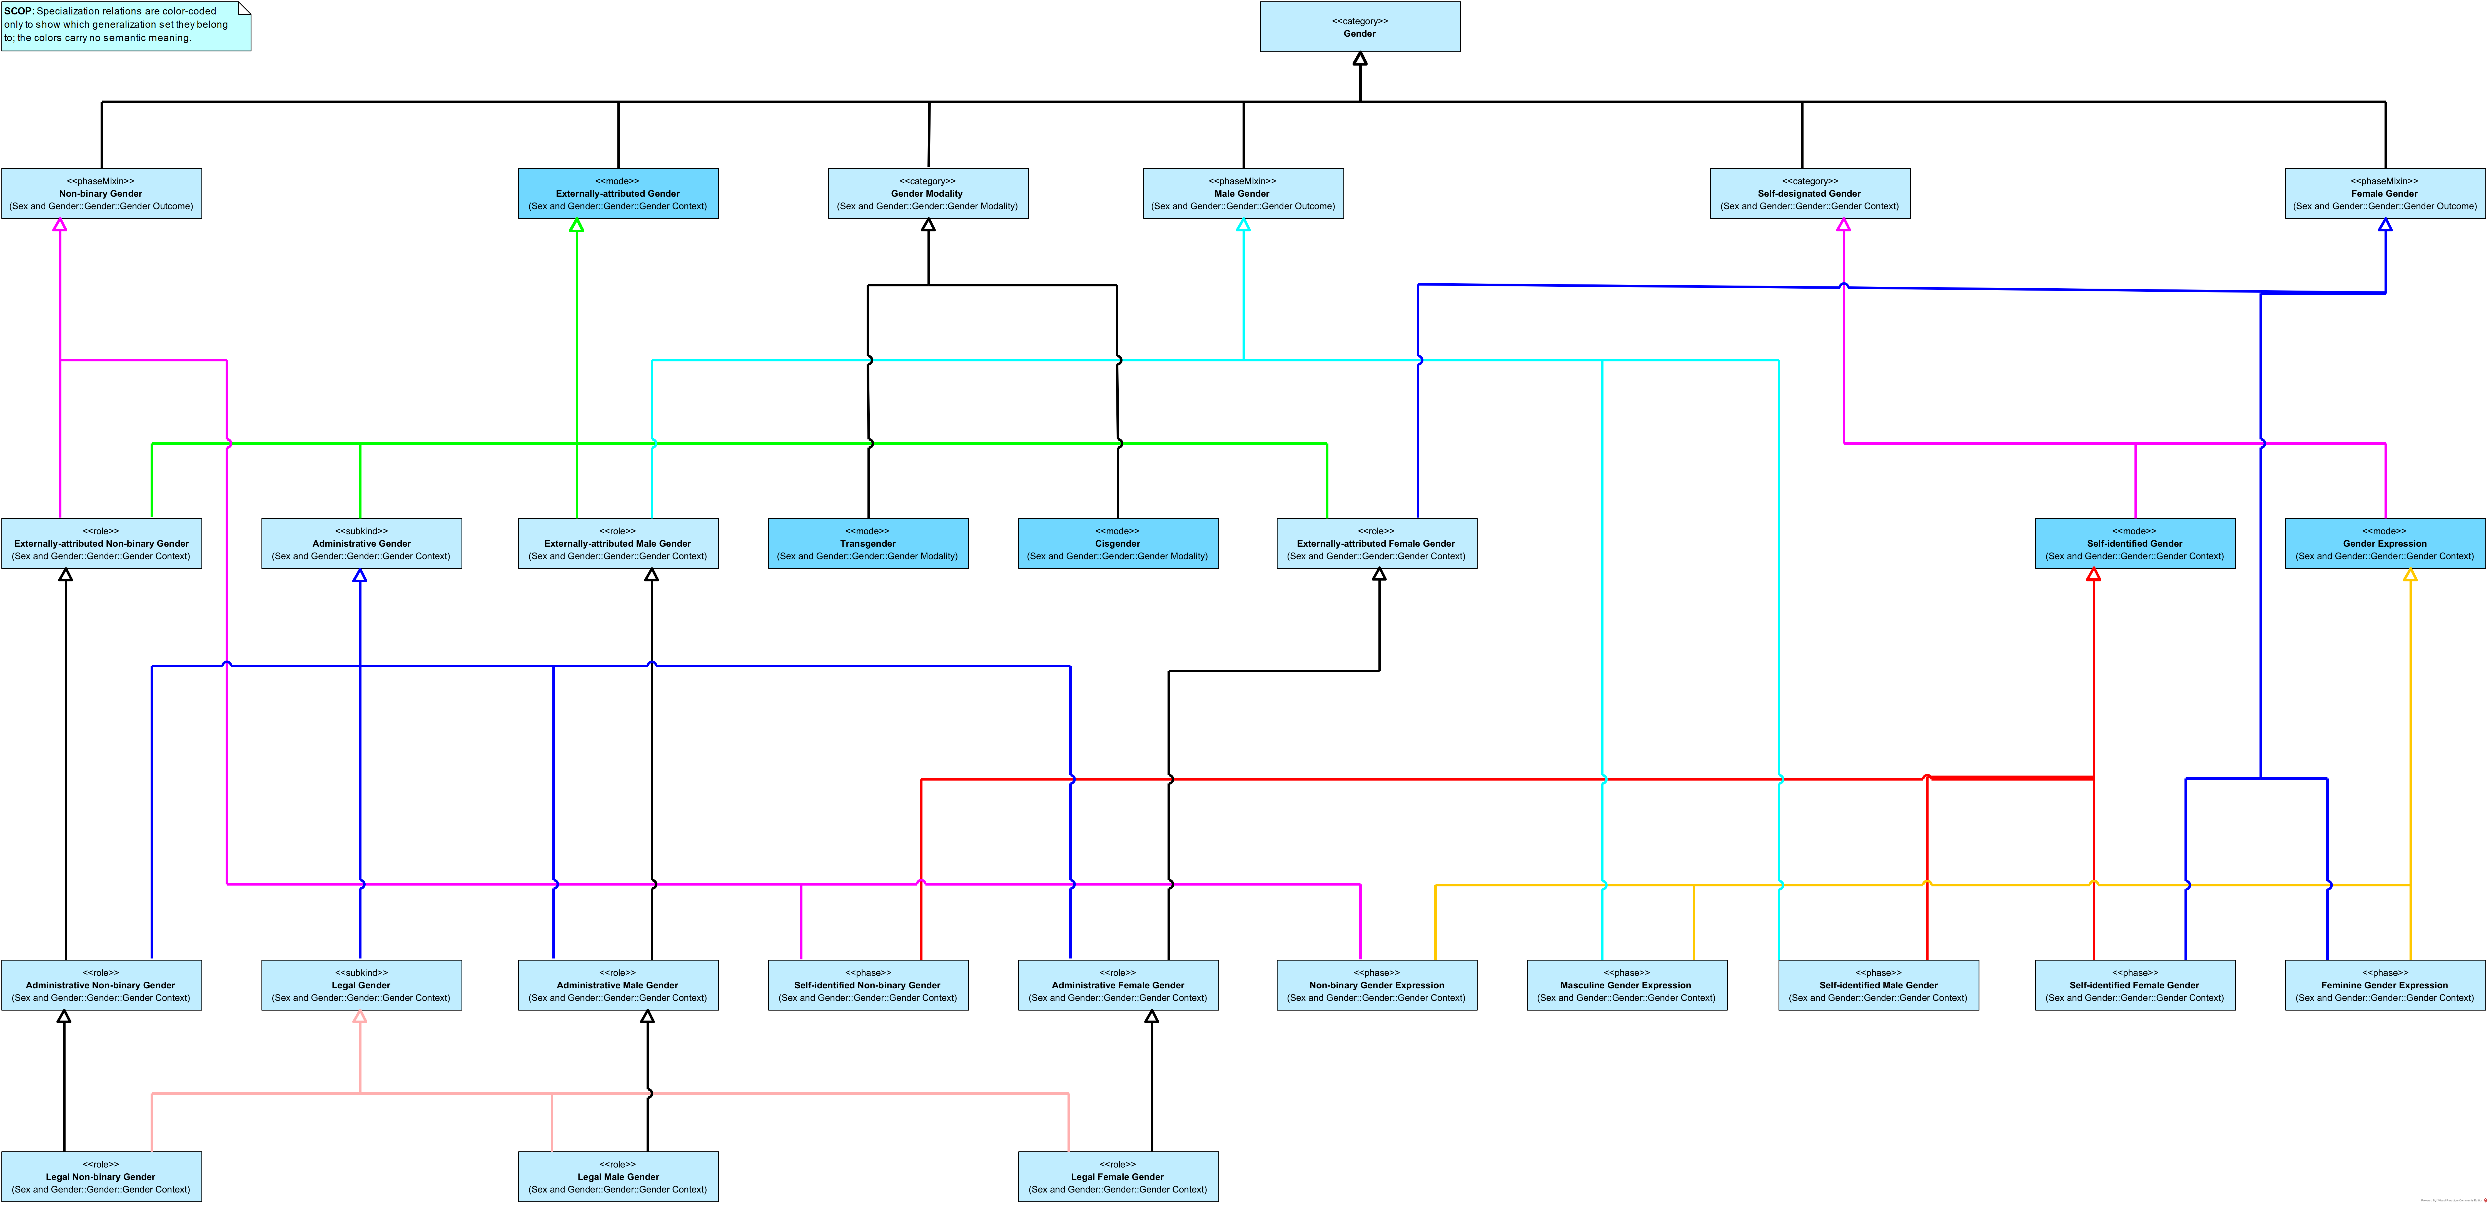
HRIO Taxonomies for Sex and Gender
Sex
Gender
Scenario 1
Notes:
This slide presents the HRIO taxonomies for sex and gender.
The details of the diagrams are not the main focus at this point. What this slide shows is that HRIO organizes these meanings into clear taxonomies.
Instead of treating all sex- and gender-related variables as one flat group, HRIO separates them into precise categories and makes their distinctions explicit.
This gives Amir a reference structure for asking better questions. For example, instead of simply asking for “gender,” he can now see that there are different kinds of gender-related concepts, connected in different ways, and identify which one best fits his study.

Slide 14

Variables Map to Distinct Meanings
care-sm:Sex
“Biological sex”@en
hri-openehr:legal-gender
“Legal gender”@en
loinc:107454-1
“Administrative gender”@en
HRIO’s Sex
HRIO’s Legal Gender
HRIO’s Administrative Gender
Scenario 1
Notes:
With these distinctions in place, Amir can use HRIO to identify the intended meaning of each dataset variable.
The Care-SM variable, labeled “Biological sex,” is linked to HRIO’s Sex concept. The openEHR-based variable, labeled “Legal gender,” is linked to HRIO’s Legal Gender concept. And the LOINC variable, labeled “Administrative gender,” is linked to HRIO’s Administrative Gender concept.
The key point is that each variable keeps its original representation, but its meaning becomes explicit.

Slide 15
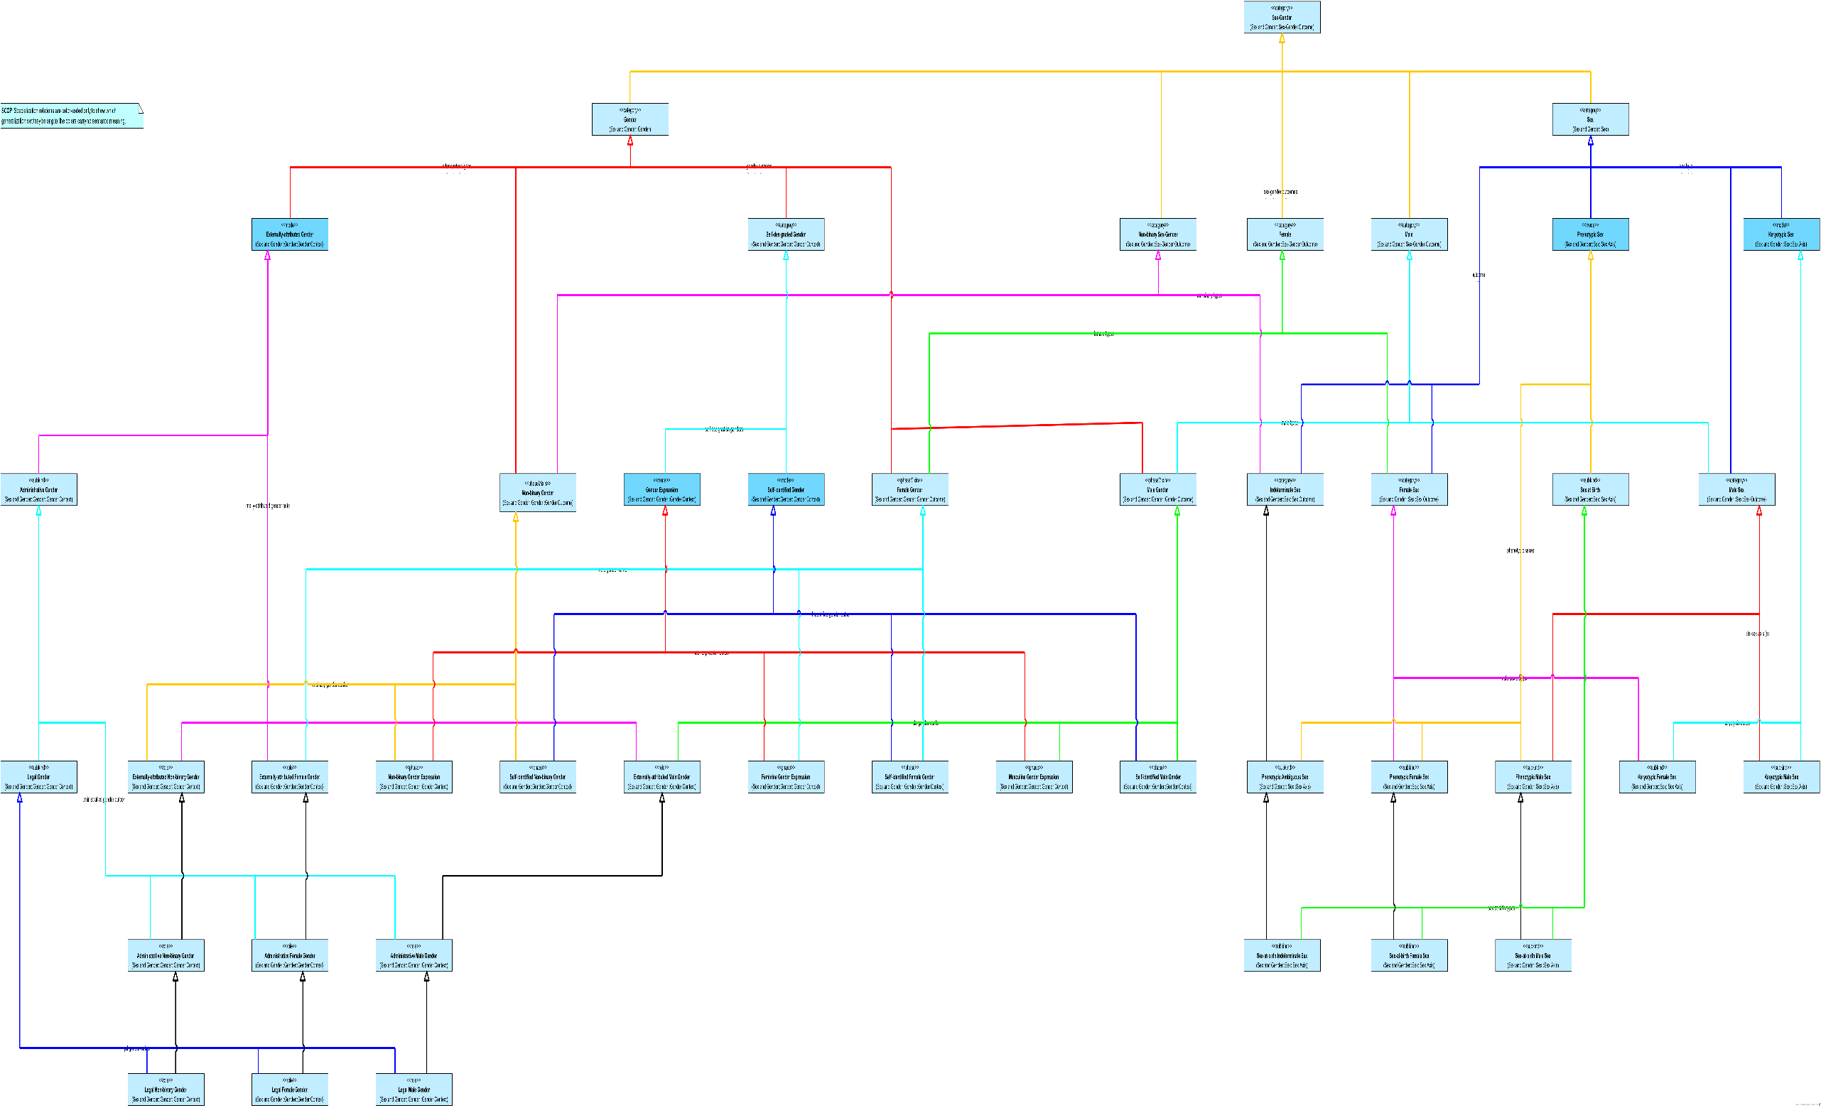
Similar Variables, Different Meanings
 | care-sm:Sex ("Biological sex"@en)
 | female
 | male
 | female
 | hri-openehr:legal-gender ("Legal gender"@en)
 | female
 | male
 | nonbinary
 | loinc:107454-1 ("Administrative gender"@en)
 | woman
 | man
 | non-binary
The variables may look comparable, but they are linked to different meanings and should not be treated as interchangeable.
Scenario 1
Notes:
We now return to the dataset variables from Amir’s scenario.
The variables may still look comparable because they contain familiar values such as female, male, woman, man, and non-binary.
But after Amir uses HRIO to identify the intended meaning of each variable, their differences become clear.
One variable is about biological sex. One is about legal gender. One is about administrative gender.
So the conclusion for this first scenario is clear: Amir should not treat these variables as interchangeable just because their labels or values look similar.
By making the meanings explicit, he can avoid label-based guessing and move toward a more defensible decision about which data can be reused for his study.

Slide 16
Scenario 2: Identify the datasets that represent the right meaning
Scenario 1: Clarify Meanings Before Reuse
Scenario 2: Identify the datasets that represent the right meaning
Result
Scenario 3
Scenario 4
Notes:
We now move from Scenario 1 into Scenario 2.
In the first scenario, Amir clarified that sex- and gender-related variables can represent different meanings. In this scenario, he applies that understanding to a practical task: moving from conceptual clarification to dataset selection.
For Amir, the issue is no longer only whether meanings differ. The next question is how those clarified meanings can help him identify the dataset that fits his study.

Slide 17
Scenario 2: Amir’s Question and Challenge
What Amir wants
Find the dataset column for biological sex so he can build a cohort that fits his research question.
Amir’s challenge
Several datasets appear relevant, but their sex/gender-related columns represent different meanings, making label-based selection unsafe.
Guiding question
Which dataset contains the variable that represents biological sex?
Notes:
In this scenario, Amir wants to identify the datasets that contain the right variable for his study: a column representing biological sex.
Several datasets may look relevant at first glance. They all contain sex- or gender-related columns, and some of their values may look familiar. But Amir knows that visible labels alone are not enough.
So the guiding question becomes: which datasets contain the variable that actually represents biological sex?

Slide 18
When are two datasets interoperable?
When can two datasets be safely reused together?
When their relevant columns implement the same standard concept.
However, this works only if (1) the standard concept is well defined, and
(2) the datasets implement it correctly.
C2
C1
C3
Standard Concepts
D1
D2
D3
D4
Dataset Columns
Scenario 2
Notes:
To understand the problem more generally, we start with a simple question: when can two datasets be safely reused together?
At the bottom, we have dataset columns. At the level above, we have standard concepts. A dataset column may implement a standard concept.
When the relevant columns from different datasets implement the same standard concept, that shared concept can provide a useful point of alignment.
However, this only works under two important conditions: the standard concept must be well defined, and the datasets must implement it correctly.
So, this model can support interoperability, but only when the shared standard concept is sufficiently precise and reliably used.

Slide 19
When are two datasets interoperable?
Can D1 and D2 be safely reused together?
Without explicit meanings, we can only see interoperability when datasets share the same standard concept.
C2
C1
C3
Standard Concepts
D1
D2
D3
D4
Dataset Columns
Scenario 2
Notes:
The next question is what happens when two dataset columns do not implement the same standard concept.
For example, can D1 and D2 be compared or combined safely?
If both columns point to the same well-defined standard concept, we have visible evidence of alignment. But if that shared concept is missing, indirect, or unclear, then interoperability becomes harder to assess.
Without explicit meanings, we can only see interoperability when datasets share the same standard concept.

Slide 20
Semantic Interoperability Conditions
We need precise and explicit meanings.
Meanings
M1
M2
If meanings differ, interoperability is not possible.
C2
C1
C3
Standard Concepts
*
D1
D2
D3
D4
Dataset Columns
Scenario 2
Notes:
Now we make the condition for semantic interoperability more explicit.
D1 and D2 may both appear relevant, and their concepts may belong to the same broad area. But once we look at the meanings layer, we see that they point to different meanings.
That difference matters. If the concepts do not share the same meaning, then the variables cannot be safely reused together.
So for Amir, this is a negative result: without shared meaning, these variables should not be treated as interoperable for his study.

Slide 21
Semantic Interoperability Conditions
We need precise and explicit meanings.
Meanings
M1
M2
If meanings differ, interoperability is not possible.
If the concepts share the same meaning, interoperability is possible.
C2
C1
C3
Standard Concepts
*
D1
D2
D3
D4
Dataset Columns
Scenario 2
Notes:
Now we see the positive case.
D1 and D2 are connected to concepts that share the same meaning. This gives us a semantic basis for comparing or reusing them together.
However, semantic compatibility is only one part of interoperability. It is necessary, but not sufficient. Other aspects still matter, such as structure, values, formats, and implementation details.
So the conclusion here is cautious but positive: D1 and D2 meet the necessary condition for interoperability.

Slide 22
From Conceptual Clarity to Actionable Semantics
The meanings are now clear in the conceptual model, but Amir still cannot query or compute over them directly.
The next step is to turn these conceptual meanings into machine-readable, queryable, and actionable relations.
hrio:Sex
hrio:LegalGender
hrio:AdministrativeGender
Meanings
care-sm:Sex
hri-openehr:legal-gender
loinc:107454-1
Standard Concepts
NPR Demographic
Extract
Hospital Registration
Extract
Administrative Intake
Extract
Dataset Columns
Scenario 2
Notes:
Back in Amir’s situation.
At this point, the relevant meanings are clear in the conceptual model. Amir can see which concepts represent biological sex, legal gender, or administrative gender.
However, this still leaves Amir with a practical limitation. The meanings are known, but they are not yet computationally actionable.
The next step is to turn these conceptual meanings into machine-readable, queryable, and actionable relations.

Slide 23
The Health-RI Computational Ontology
The Health-RI Semantic Interoperability Initiative
1
Conceptual clarification:
Meanings are precise and explicit
HRIM
Mapping Set
HRIO
Conceptual
2
Computational tractability:
Machine-readable relations
HRIO
Computational
Scenario 2
Notes:
Earlier, we introduced HRIO as a way to support conceptual clarification: meanings are made precise and explicit.
We now move from conceptual clarification to computational tractability.
This is where the computational version of HRIO comes in. It represents the relevant meanings and their relations in machine-readable form, so they can be queried, processed, and reused.
In other words, the computational ontology turns conceptual distinctions into something that can support Amir’s dataset discovery task.

Slide 24
From Conceptual Clarity to Actionable Semantics
Amir can now query for dataset columns that are mapped to the meaning he needs: HRIO’s Sex.
input
hrio:Sex
hrio:LegalGender
hrio:AdministrativeGender
Meanings
SELECT DISTINCT ?output
WHERE {
VALUES ?input { hrio:Sex }
?mapping a demo:Mapping ;
demo:hasMappingSource ?concept ;
demo:hasTargetMeaning ?input .
?output demo:implementsConcept ?concept .
}
ORDER BY ?output
care-sm:Sex
hri-openehr:legal-gender
loinc:107454-1
Standard Concepts
NPR Demographic
Extract
Hospital Registration
Extract
Administrative Intake
Extract
Dataset Columns
output
Scenario 2
Notes:
We now reach the result of Scenario 2.
The meanings are now not only clear, but also computationally actionable. Amir can query for dataset columns that are mapped to the meaning he needs: biological sex, represented here as HRIO’s Sex.
In this example, the query returns the NPR Demographic Extract, because its column is mapped to the biological sex meaning.
So, Amir no longer has to rely only on labels or manual inspection. He can use explicit, machine-readable semantic relations to identify the dataset that contains the right variable for his study.

Slide 25
Scenario 3: Use Mappings to Connect Data and Infer Reuse Knowledge
Scenario 1: Clarify Meanings Before Reuse
Scenario 2: Identify the datasets that represent the right meaning
Result
Scenario 3: Use Mappings to Connect Data and Infer Reuse Knowledge
Scenario 4
Notes:
Scenario 3 introduces mappings as reusable knowledge for data reuse.
In Scenario 2, Amir used explicit meanings to identify the dataset column that represents biological sex. The next step is to reuse existing mapping knowledge.
In this scenario, Amir will use external mappings not as isolated links, but as resources that can support later reuse decisions.

Slide 26
Scenario 3: Amir’s Question and Challenge
What Amir wants
Apply reusable mappings to relate dataset variables, standard concepts, and explicit meanings.
Amir’s challenge
The meanings are explicit and machine-readable, but these relationships must be captured as reusable mappings.
Guiding question
How can mappings turn these relationships into reusable knowledge?
Notes:
This slide presents Amir’s goal and challenge in Scenario 3.
Amir wants to apply reusable mappings to relate dataset variables, standard concepts, and explicit meanings. The meanings are already clear and machine-readable, but the relationships between them still need to be captured in a reusable form.
So the guiding question is: how can mappings turn these relationships into reusable knowledge, rather than leaving Amir dependent on one-off comparisons between individual concepts or datasets?

Slide 27
External Mappings
source_CURIE | source_label | target_CURIE | target_label
cdisc-sdtm:DM.SEX | Sex | care-sm:Sex | Biological sex
ncit:C28421 | Sex | care-sm:Sex | Biological sex
 | care-sm:Sex ("Biological sex"@en)
 | female
 | male
 | female
Clinical Research Standards Mapping Community
source_CURIE | source_label | target_CURIE | target_label
npr:person.sex_code | Registered biol. sex | care-sm:Sex | Biological sex
npr:person.sex_code | Registered biol. sex | registry:resident.sex | Resident sex
fhir:Patient.gender | Administrative gender | hl7v3:AdmGender | Administrative gender
 | hri-openehr:legal-gender ("Legal gender"@en)
 | female
 | male
 | nonbinary
Dutch Health Data Stewardship Community
 | loinc:107454-1 ("Administrative gender"@en)
 | woman
 | man
 | non-binary
source_CURIE | source_label | target_CURIE | target_label
loinc:107454-1 | Administrative gender | fhir:Patient.gender | Administrative gender
loinc:107454-1 | Administrative gender | hl7v2:0001 | Administrative sex
Administrative Gender Standards Community
Scenario 3
Notes:
This slide introduces the external mappings available to Amir in Scenario 3.
The three original datasets remain the starting point. What changes here is the addition of mapping sets from different communities, including clinical research standards, administrative gender standards, and Dutch health data stewardship.
These mapping sets provide existing links between dataset variables, standard concepts, and related representations.
In the next slides, we will use them to show how Amir can reuse existing mapping knowledge.

Slide 28
Pairwise Mappings Require Multiple Steps
Without a meaning layer, reuse depends on chains of concept-to-concept mappings.
These mappings are often fragile and label-driven.
Each new concept adds complexity, making maintenance harder.
source_CURIE | target_CURIE
cdisc-sdtm:DM.SEX | care-sm:Sex
ncit:C28421 | care-sm:Sex
A
C
B
From E to A: 3 steps
From J to A: 4 steps
source_CURIE | target_CURIE
npr:person.sex_code | care-sm:Sex
npr:person.sex_code | registry:resident.sex
fhir:Patient.gender | hl7v3:AdmGender
D
From Z to A: N steps
E
A
E
F
I
F
Standard Concepts
C
J
H
source_CURIE | target_CURIE
loinc:107454-1 | fhir:Patient.gender
loinc:107454-1 | hl7v2:0001
H
G
B
D
G
I
Scenario 3
Notes:
Here, the concepts in the mapping sets are represented as letters so that the mapping structure is easier to see.
The main point is that pairwise mappings create a network of concept-to-concept links. To assess reuse, Amir may need to reconstruct a path by following several mappings from one concept to another. In the current network, the path from E to A already takes three steps. When another concept is added, as illustrated by J, the path can become even longer.
The problem is not only the number of steps. A path may look like evidence of semantic alignment, but it only shows that concepts are connected through mappings. It does not guarantee that the intended meaning is preserved from end to end. If the mappings are fragile or driven mainly by labels rather than explicit meanings, Amir cannot safely rely on that path for reuse decisions.
This same risk compounds as the network grows. Each new concept can introduce more paths that appear to support reuse, while still depending on the quality of each pairwise mapping. The result is a network that becomes harder to scale, harder to maintain, and harder to interpret safely.

Slide 29
The Health-RI SSSOM Mapping Set (HRIM)
The Health-RI Semantic Interoperability Initiative
HRIM
Mapping Set
HRIO
Conceptual
HRIO
Computational
Semantic mappings move reuse
from fragile pairwise mappings
to a hub-and-spoke model.
3
Scenario 3
Notes:
We now introduce the third deliverable of the initiative: the Health-RI SSSOM Mapping Set.
This is a curated collection of mappings that links external terms, dataset variables, and standard concepts to explicit HRIO meanings. It uses SSSOM as a structured, machine-readable format, so the mappings can be published, inspected, and reused.
This matters because mapping knowledge becomes an explicit artifact. Amir does not only see an isolated connection; he can rely on a traceable mapping record as part of a more defensible reuse decision.

Slide 30
Meaning-Based Mappings Shorten Reuse Paths
From E to A: 2 steps
Shared meanings create a common semantic hub. Paths are shorter and clearer.
Semantic alignment is based on explicit meanings, not labels.
Adding concepts creates more reusable knowledge for future queries, enriching the network without increasing path complexity.
From J to A: 2 steps
X
From Z to A: 2 steps
Meanings
Y
A
E
F
I
Standard Concepts
C
J
H
B
D
G
Scenario 3
Notes:
This slide shows the architecture proposed by the initiative: a move from pairwise mappings to a meaning-based hub-and-spoke structure.
In the previous slide, Amir had to follow chains of mappings from one concept to another. Here, the meaning layer becomes the central access point. Each standard concept connects to an explicit meaning, and concepts can then be compared through that shared semantic hub.
This makes reuse paths shorter and more predictable. The path from E to A is now two steps. And if a new concept is added later, as illustrated by J, it can also connect through the meaning layer without creating a longer chain of pairwise mappings.
This makes the mapping structure easier to interpret, easier to maintain, and more scalable for future reuse.

Slide 31
Amir Assesses Reuse Through Semantic Relations
Biological sex does not align with the gender-based variables.
Legal gender and administrative gender are related, but only partially align.
Amir can now rule out unsafe reuse.
hrio:Sex
hrio:LegalGender
hrio:AdministrativeGender
Meanings
care-sm:Sex
hri-openehr:legal-gender
loinc:107454-1
Standard Concepts
NPR Demographic
Extract
Hospital Registration
Extract
Administrative Intake
Extract
Dataset Columns
Scenario 3
Notes:
We now return to Amir’s case and use the semantic relations to assess reuse.
The result is clear. The biological sex variable does not align with the gender-based variables. Legal gender and administrative gender are related, but only partially aligned.
This is the key conclusion of Scenario 3. The mappings do not simply show that concepts are connected. They help Amir distinguish where variables align, where they only partially overlap, and where reuse should be ruled out.
With this, Amir can move from interpreting individual mappings to using mapping knowledge as reusable evidence for safer data reuse decisions.

Slide 32
Scenario 4: Query Semantic Knowledge Across Variables and Meanings
Scenario 1: Clarify Meanings Before Reuse
Scenario 2: Identify the datasets that represent the right meaning
Result
Scenario 3: Use Mappings to Connect Data and Infer Reuse Knowledge
Scenario 4: Query Semantic Knowledge Across Variables and Meanings
Notes:
We now enter the final scenario.
So far, Amir has built the semantic context needed for reuse. He has clarified the meanings of the variables, identified which ones match his study needs, and used mappings to distinguish alignment, partial overlap, and unsafe reuse.
Scenario 4 brings this context into action. Amir can now query the connected semantic knowledge to support concrete reuse decisions.

Slide 33
Scenario 4: Amir’s Question and Challenge
What Amir wants
Query semantic context, mappings, and inferred knowledge to support data reuse decisions.
Amir’s challenge
Amir needs to move from connected semantic knowledge to queries that support concrete reuse decisions.
Guiding question
How can Amir query semantic knowledge to support practical data reuse decisions?
Notes:
This slide makes Amir’s final task explicit.
Amir now wants to query the available semantic knowledge: dataset variables, standard concepts, HRIO meanings, mappings, and inferred relations.
The challenge is to turn this connected knowledge into practical support for reuse decisions. Amir needs queries that can help him find relevant variables, compare concepts, and assess whether reuse is safe, partial, or inappropriate.
So the guiding question is: how can Amir query semantic knowledge to support practical data reuse decisions?

Slide 34
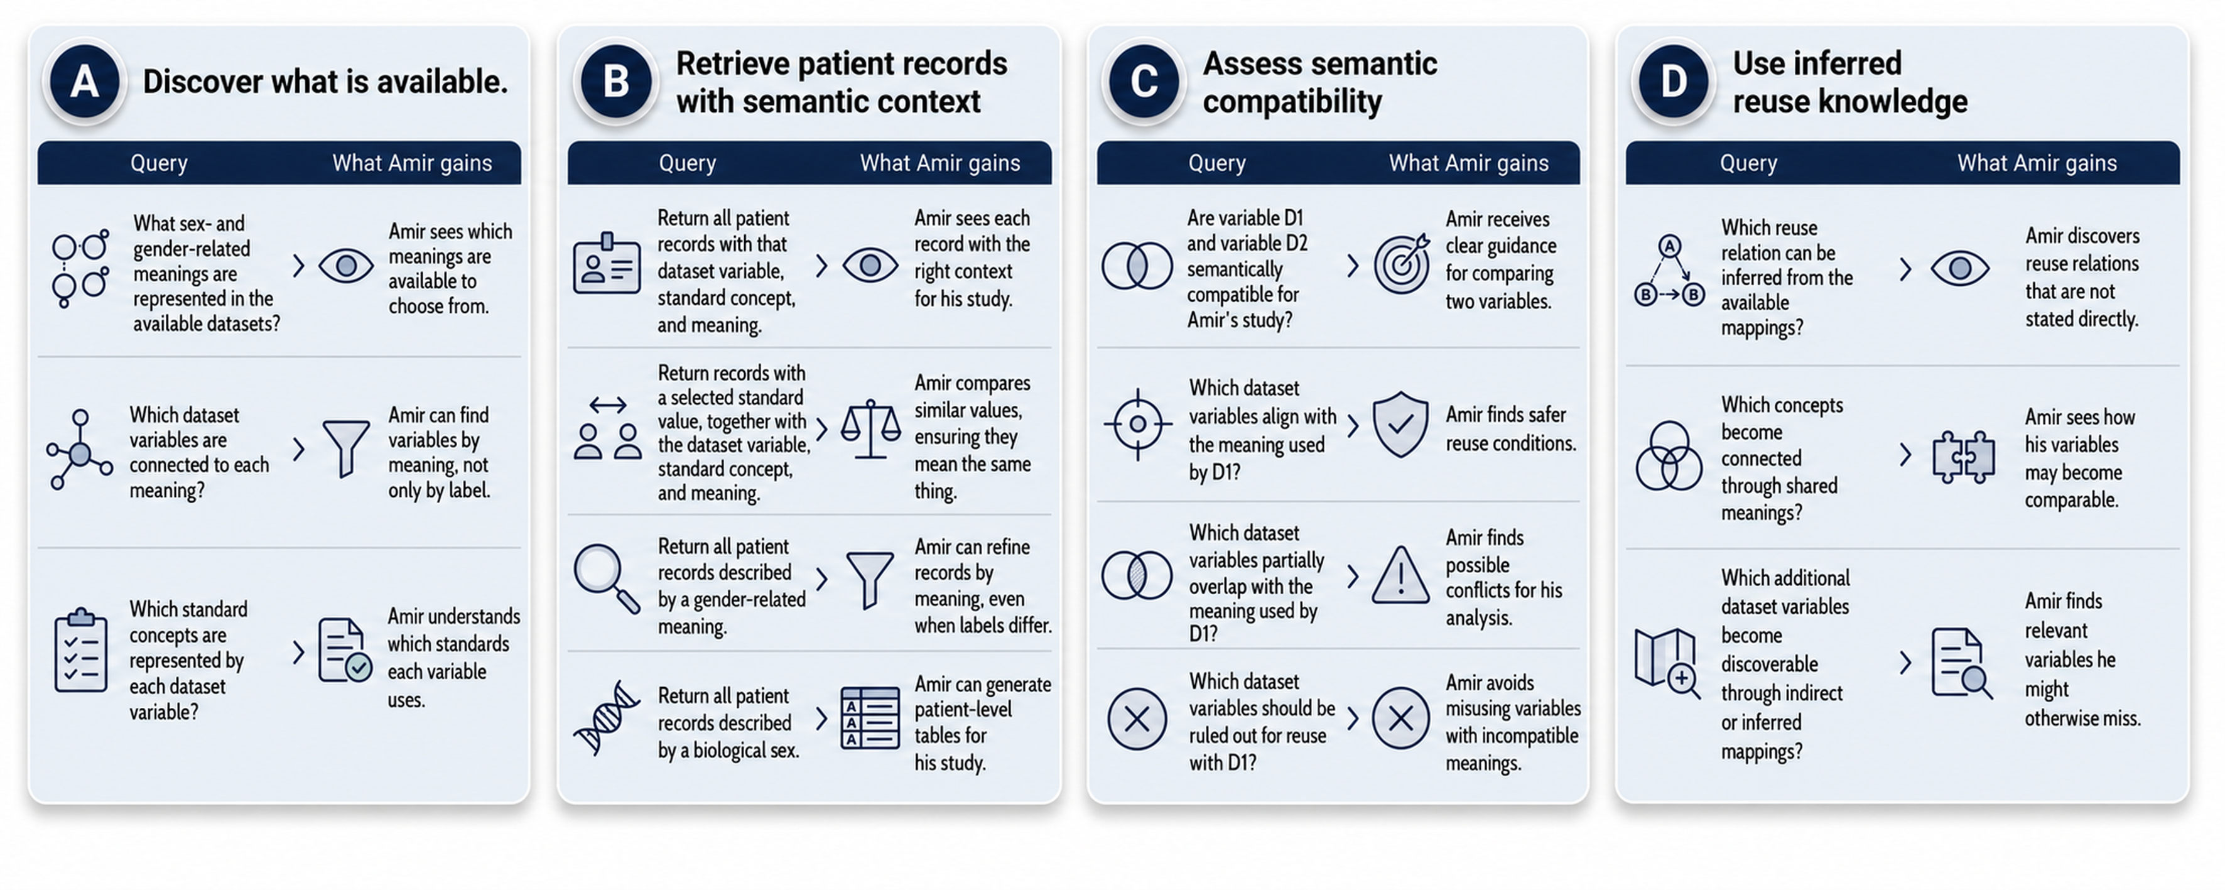
Amir’s Possible Queries
Notes:
This slide shows the kinds of questions Amir can now ask with the connected semantic knowledge.
The four panels move from discovery to decision support. First, Amir can discover which meanings, variables, and standards are available. He can then retrieve patient records together with their dataset variable, standard concept, and meaning. Next, he can assess semantic compatibility: which variables align, which only partially overlap, and which should be ruled out. Finally, he can use inferred knowledge to discover reuse relations that were not stated directly.
The goal is not to walk through every example. The goal is to show that Amir can now ask more precise, traceable, and decision-oriented questions about data reuse.

Slide 35
Result of Amir’s Workflow
Scenario 1: Clarify Meanings Before Reuse
Scenario 2: Identify the datasets that represent the right meaning
Result:
Amir could move from label-based guessing to query-supported reuse decisions, using meanings, mappings, and inferred knowledge to query relevant variables, compare concepts, and assess which ones align, partially overlap, or should not be reused together.
Scenario 3: Use Mappings to Connect Data and Infer Reuse Knowledge
Scenario 4: Query Semantic Knowledge Across Variables and Meanings
Notes:
This final slide closes Amir’s workflow.
He started with a common reuse problem: several datasets appeared to contain relevant sex- or gender-related variables, but their meanings were not necessarily the same.
Across the workflow, Amir moved from label-based uncertainty to explicit meanings, from conceptual clarification to dataset selection, from reusable mappings to query-supported reuse decisions.
The result is not just better documentation. Amir can use semantic knowledge as evidence for reuse: to find relevant variables, compare concepts, and assess where variables align, partially overlap, or should not be reused together.
That is the value of the workflow: data reuse decisions become more precise, more traceable, and more defensible.

Slide 36

Thank you!
https://w3id.org/
health-ri/semantic-interoperability
Pedro Paulo F. Barcelos {Pedro.Barcelos@health-ri.nl}, Niek van Ulzen,
Reinier Groeneveld, Ana Konrad, Douwe Spaanderman, and Shuxin Zhang
Notes:
Thank you for your attention.
You can find more information about the Health-RI Semantic Interoperability Initiative using the link or QR code shown on this slide.

Slide 37
Meanings Are Necessary, but not Sufficient
Semantic alignment is necessary for interoperability, but it is not sufficient on its own.
Intersecting meanings
Disjoint meanings
Subset relation
Semantic relationship between concepts:
Strong overlap: interoperability is more likely, though full preservation of meaning is not guaranteed.
Partial overlap: interoperability is possible, but carries a significant risk of semantic distortion.
No overlap: semantic interoperability is not possible.
Scenario 2
Notes:
TO BE DONE.

Slide 38
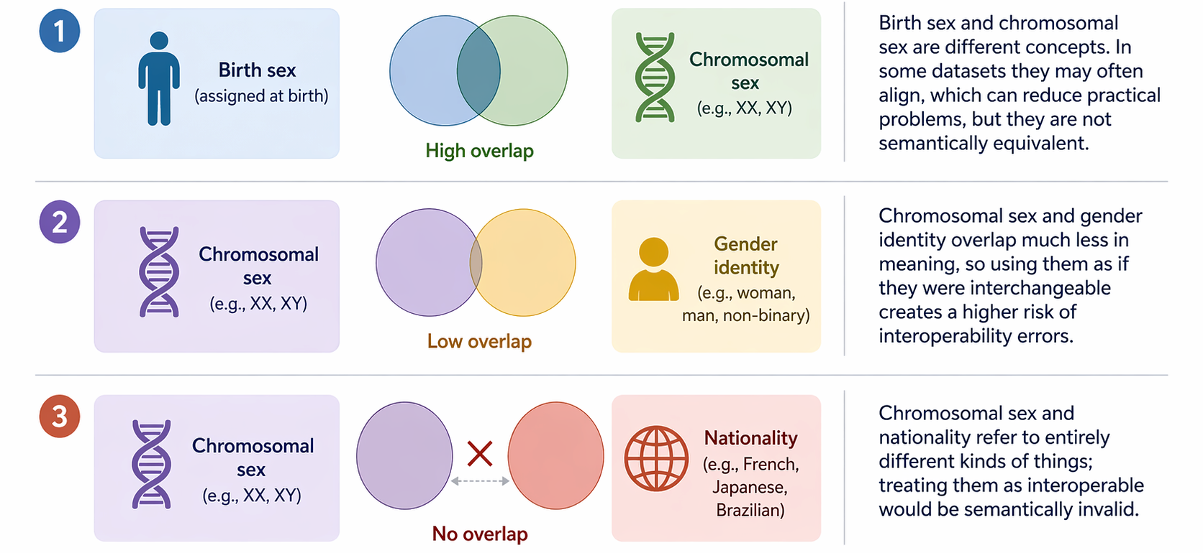
Examples of Semantic Similarity and Difference
Scenario 2
Notes:
TO BE DONE.

Slide 39
Exact Meaning is not Enough
If two concepts share exactly the same meaning, that supports semantic interoperability, but it still does not guarantee interoperability overall.
Exact meanings
Format/syntax:
JSON vs XML vs CSV
Data model/structure:
different fields, nesting, cardinalities
A=B
Value representation:
codes, labels, datatypes, date formats
Units/scales:
kg vs lb, Celsius vs Fahrenheit
Identifiers/references:
different IDs for the same entity
Constraints/business rules:
required fields, validation rules
Protocol/transport:
API, file exchange, messaging differences
Scenario 2
Notes:
TO BE DONE.

